Slide 1
Integration and Practice

Slide 2
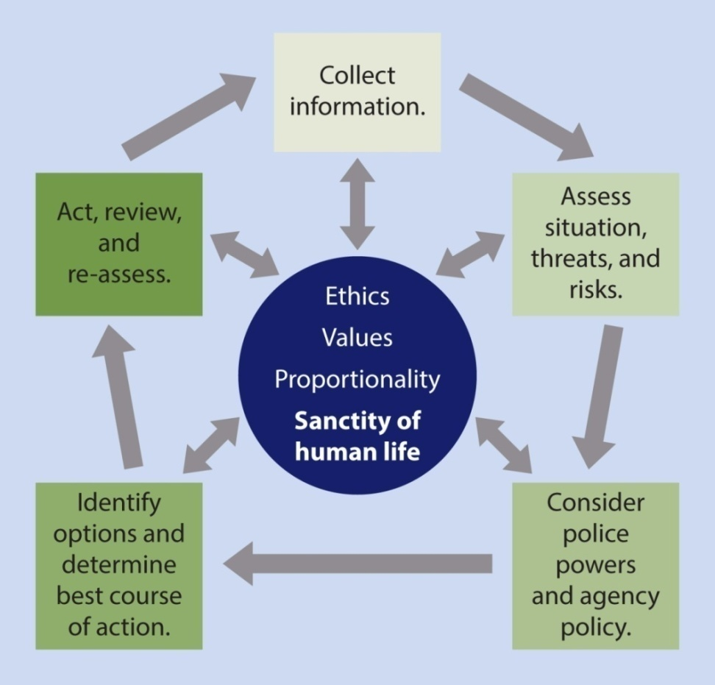
Integration and Practice
Critical Decision-Making Model

Slide 3
Integration and Practice
Critical Decision-Making Model
Benefits
Better and safer decisions up front
Better explanation of those decisions after the fact

Slide 4
Integration and Practice
Crisis Recognition
Key Takeaways
Recognizing someone in crisis helps shape your response
Your role is not to diagnose and treat – it’s to understand and begin to defuse

Slide 5
Crisis Recognition
Mental
Illness
Substance
Abuse
Emotionally Distressed Person
Medical Condition
Situational
Stress
Adapted from Nassau County, NY Police Department
Notes:
Call on Jeff Thompson

Slide 6
Integration and Practice
Crisis Recognition – Suicide by Cop
Key Takeaways
Subjects will communicate suicidal intent and act in a threatening manner to force officers to act
As many as 36% of all officer involved shootings were suicide by cop attempts
81% of suicide by cop attempts were spontaneous
Subjects became suicidal in response to police intervention

Slide 7
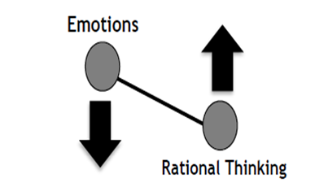
Integration and Practice
Tactical Communications
Key Takeaways
Bring balance to the Emotional-Rational Thinking Scale
Stabilizing/safely maintaining the scene until specialists arrive is a victory

Slide 8
Integration and Practice
Tactical Communications
Key Takeaways
Active listening
80-20 principle
Listen to understand, not respond
Demonstrate you are listening
Show empathy and respect

Slide 9
Integration and Practice
Tactical Communications
Key Takeaways
Non-verbal communications
Body language
Eye contact
Open-handed gestures
Tone of voice

Slide 10
Integration and Practice
Tactical Communications
Key Takeaways
Verbal communications
Team concept (contact and cover)
Clear, single questions/commands
Ask open-ended questions
Provide options
Emotional Contagion

Slide 11
Integration and Practice
Operational Tactics
Key Takeaways
Pre-response
Collect information
Slow down (“tactical pause”)
Develop a working strategy
Prepare and manage yourself

Slide 12
Integration and Practice
Operational Tactics
Key Takeaways
Response
Teamwork
Distance + Cover = Time
Tactical positioning/repositioning
Put yourself in a winnable situation

Slide 13
Integration and Practice
During a suicide by cop situation
Officers must be extra vigilant to not escalate the situation
Distance + Cover = Time
Call for backup
Keep spinning the CDM and constantly assess the threat
Try not to let the subject force you to take action
Try not to initiate confrontation
Maintain communication to make a connection and begin crisis intervention

Slide 14
Integration and Practice
Operational Tactics
Key Takeaways
Post-Response
After-Action Reviews
Not grading past success or failure
Improving future performance

Slide 15
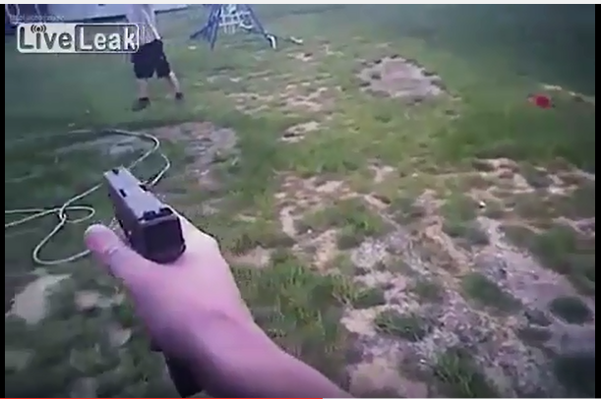
Integration and Practice
Shenandoah County, VA
Man-with-a-Knife Incident: Dec. 14, 2015
Notes:
Link to video: https://www.youtube.com/watch?v=TKOSDh4lvM4

Slide 16
Integration and Practice
Thoughts?
Questions?
Observations?

