Slide 1
Operational Tactics

Slide 2
Operational Tactics
St. Louis Incident
Notes:
Video link: https://www.youtube.com/watch?v=2ImlYme93Po

Slide 3
Operational Tactics
Questions to Consider
What are key things you want to know ahead of time and steps to take when you first arrive on scene?
How can you better respond tactically to incidents like this?

Slide 4
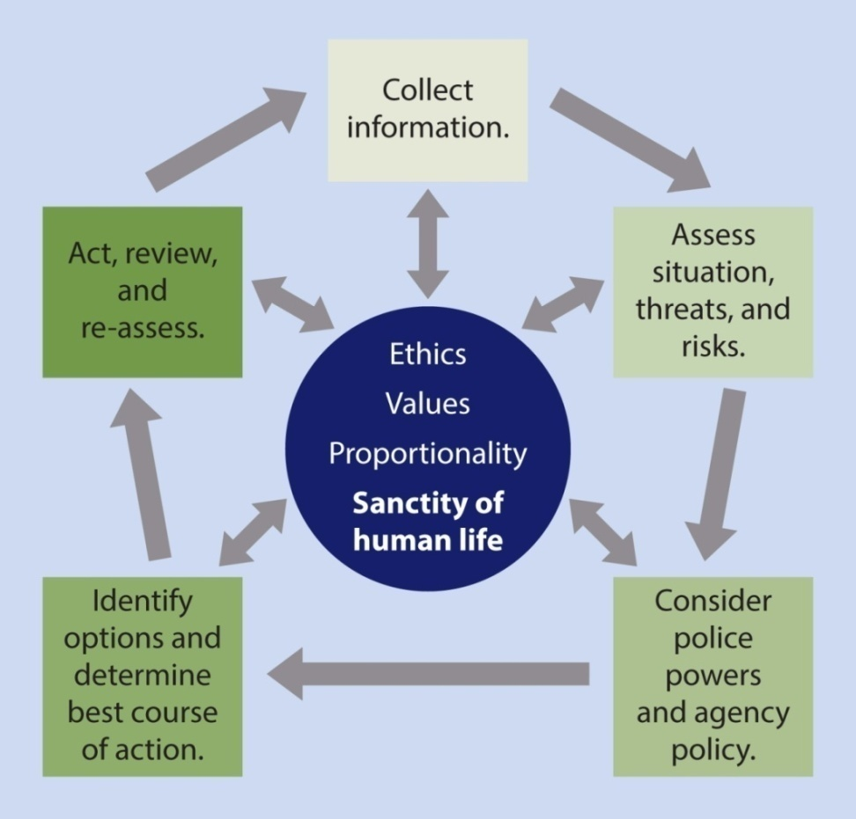
Operational Tactics
Critical Decision-Making Model

Slide 5
Operational Tactics
Pre-Response Considerations—What do you think about before you arrive on scene?
Notes:
Add a note on CDM?

Slide 6
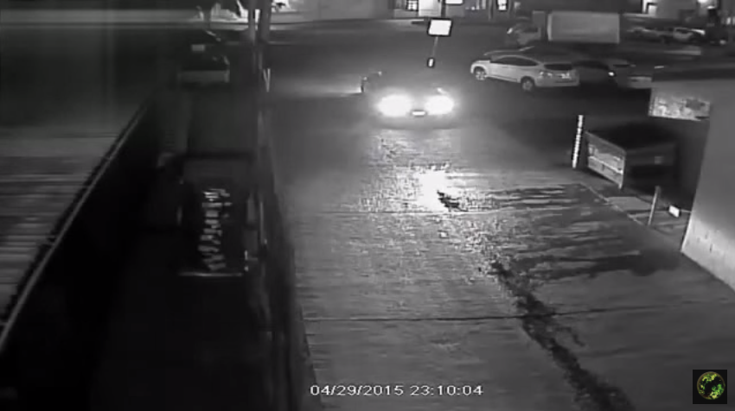
Operational Tactics
San Diego, California – April 29, 2015
Notes:
https://www.youtube.com/watch?v=t-X0WL_buVc

Slide 7
“21-foot rule”
Operational Tactics
“When I first came on we would always use the 21-foot rule. If they’re within 21 feet, they can be on top of you and stabbing you before you react to that. But now I think they’re trying to extend that distance out even further because I think there is documentation now that someone armed with a knife can literally run up on someone before you’re able to react to that, or already being stabbed.”
- San Diego Officer Neal Browder, in a statement to investigators regarding his April 2015 officer-involved shooting

Slide 8
Operational Tactics
Pre-Response
Collect information
Step 1 of the Critical- Decision Making Model

Slide 9
Operational Tactics
Pre-Response
Collect information
“Tactical pause” (when possible)

Slide 10
Operational Tactics
Pre-Response
Collect information
“Tactical pause” (when possible)
Develop a working strategy

Slide 11
Operational Tactics
Pre-Response
Collect information
“Tactical pause” (when possible)
Develop a working strategy
Prepare/manage yourself

Slide 12
Operational Tactics
Pre-Response
Collect information
“Tactical pause” (when possible)
Develop a working strategy
Prepare/manage yourself
Be prepared to intervene with your partners

Slide 13
Operational Tactics
Pre-Response Considerations
Effective Response Tactics

Slide 14
Operational Tactics
Response
Operate as a team
Everyone has a role
Stick to your role/Stay in your lane
Contact and cover
Formal and/or informal leader on the scene

Slide 15
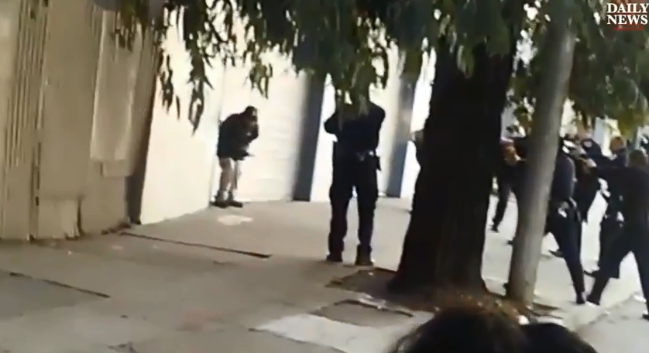
Operational Tactics
San Francisco: Mario Woods incident
Dec. 2, 2015
Notes:
Link to video: https://www.youtube.com/watch?v=v0ju6RQkNs8

Slide 16
Operational Tactics
Response
Operate as a team
Distance + Cover = Time

Slide 17
Operational Tactics
Response
Operate as a team
Distance + Cover = Time
First impressions – how do you want to start the interaction?

Slide 18
Operational Tactics
Response
Operate as a team
Distance + Cover = Time
First impressions
Continue gathering information

Slide 19
Operational Tactics
Response
Operate as a team
Distance + Cover = Time
First impressions
Continue gathering information
Tactical Positioning/Repositioning

Slide 20
Operational Tactics
Tactical Positioning/Repositioning
Don’t draw a line in the sand
Maintain a position of advantage
Give yourself a “reaction gap”
This is not an arbitrary number!
“Tactical Mambo”
Reposition yourself/team as the situation evolves

Slide 21
Operational Tactics
Response
Continue gathering information
First impressions
Operate as a team
Distance + Cover = Time
Tactical Positioning/Repositioning
Keep yourself in a winnable situation

Slide 22
Operational Tactics
Keep yourself in a winnable situation
Isolate the subject
Communicate tactically
Keep your options open
Intervene only if there is an immediate threat

Slide 23
Operational Tactics
Response
Continue gathering information
First impressions
Operate as a team
Distance + Cover = Time
Tactical Positioning/Repositioning
Keep yourself in a winnable situation
Have a Plan B

Slide 24
Operational Tactics
Have a Plan B
There are multiple opportunities for success
Spin the model
Get ready to move/tactically reposition
Assess your next step
If the Taser (or other less-lethal option) fails, then what?

Slide 25
Operational Tactics
Tactical Equipment
When possible and appropriate, officers should utilize department-issued tactical equipment
Increasea officer safety
Helps effectively contain, isolate, or subdue subjects in crisis

Slide 26
Operational Tactics
Tactical Equipment can include:
Shields
Bean bag shotgun
40mm foam projectiles
Electronic Control Weapons (ECWs)
Rope (to tie off doors)
Y-bar
Water cannon

Slide 27
Operational Tactics
Baltimore (MD): Man with a Knife
Sept. 6, 2017
Notes:
Link to video:

Slide 28
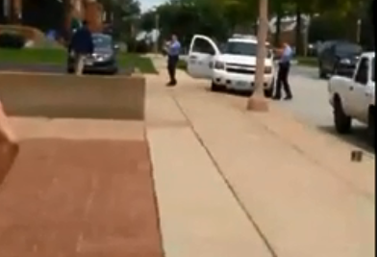
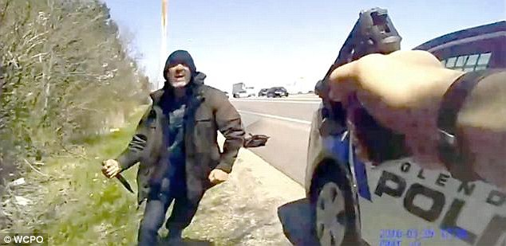
Operational Tactics
Tactics for Suicide by Cop Situations

Slide 29
Operational Tactics
Suicide by Cop
How does this change what we do tactically?

Slide 30
Operational Tactics
What are 3 things that would tip us off that this might be a suicide by cop scenario?
Voluntarily enters into confrontation
Will communicate suicidal intent
Act in a threatening manner forcing you to respond

Slide 31
Operational Tactics
Officers must be extra vigilant to not escalate the situation... How?
Distance + Cover = Time
Call for backup
Continuously assess the threat
Keep spinning the CDM
Remain in control of the situation
Try not to let the subject force you to take action
Try not to initiate confrontation
Maintain communication
Attempt to begin crisis intervention
Use the tools available to you

Slide 32
Operational Tactics
Pre-Response Considerations
Effective Response Tactics
Post-Response Considerations

Slide 33
Operational Tactics
After-Action Review basics
Conducted soon after a critical incident
Focus on objectives, actions, decision-making
Continuous learning and improvement
Improving future performance (not grading past actions)

Slide 34
Operational Tactics
AAR ground rules
Inclusive process
Facilitators are key – but they don’t control the process
Leave egos in the locker room

Slide 35
Operational Tactics
AAR process and format
Review incident objectives
Run through chronological sequence
Use open-ended questions
Summarize major learning points
Identify any next steps (training, policy changes, etc.)

Slide 36
Operational Tactics
AARs and the Critical Decision-Making Model
Useful tools for examining decision-making behind actions taken
CDM is a documentation and learning tool – not a punitive or disciplinary instrument

Slide 37
Operational Tactics
Quick Recap
Collect information, strategize before you arrive on scene (“tactical pause”)
Once on scene … think teamwork, distance + cover = time, tactical repositioning, “winnable situations”
Suicide-by-cop situations require even greater tactical vigilance
After actions are all about improving future performance

Slide 38
Operational Tactics
Thoughts?
Questions?
Observations?

