Slide 1
Tactical Communications

Slide 2
Tactical Communications
Notes:
Video Link: https://www.youtube.com/watch?v=-W08Y2moPrA

Slide 3
Tactical Communications
Question to Consider
What makes a police officer a good communicator? What attributes and skills must the officer possess?

Slide 4
Tactical Communications
Five Universal Truths of Human Interaction
People feel the need to be respected
People would rather be asked than be told
People have a desire to know why
People prefer to have options over threats
People want to have a second chance
Source: Dr. George Thompson, Verbal Judo Institute

Slide 5
Tactical Communications
Crisis Intervention
A process to assist individuals in finding safe and productive outcomes to unsettling events
Adapted from Police Training Institute
University of Illinois

Slide 6
Tactical Communications
Two Principles Guiding Your Response
Your mission is not to diagnose or treat/solve underlying issues
Your top priority is to verbally defuse and stabilize the situation, when feasible

Slide 7
Tactical Communications
Three-Phase Response Process
Ensure the scene is safe
Try to get the person stabilized
Begin the problem-solving process (often by bringing in other resources)

Slide 8
Tactical Communications
Trying to Defuse a Critical Situation Does Not…
Take away your discretion to make an arrest, where probable cause exists
Restrict your ability to use force when faced with an imminent threat
But these should be considered last resorts whenever possible

Slide 9
Tactical Communications
How To Approach Persons in Crisis – Some Practical Tips and Techniques
Request backup & specialized help
Don’t rush (unless immediate action is needed)
Continually assess and re-assess
Be aware of “hot buttons” and “hooks”

Slide 10
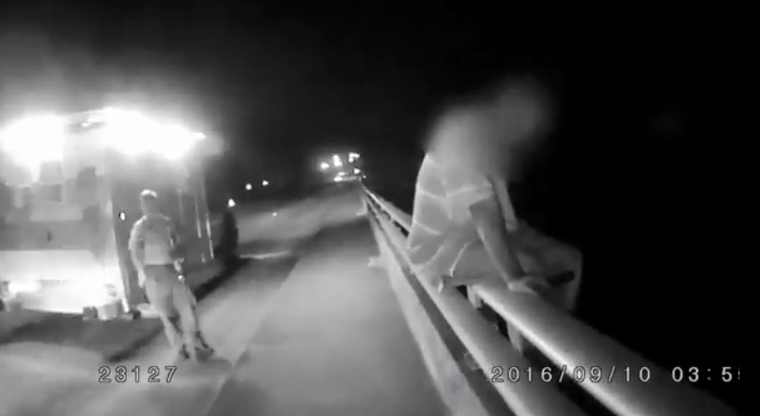
Tactical Communications
Columbia, SC
Notes:
Link to video: https://www.youtube.com/watch?v=58FfkuJZRJE

Slide 11
Tactical Communications
How To Approach Persons in Crisis – Some Practical Tips and Techniques
Request backup & specialized help
Don’t rush (unless immediate action is needed)
Continually assess and re-assess
Be aware of “hot buttons” and “hooks”
Consider “doing the opposite"
Always be respectful

Slide 12
Tactical Communications
Perfect 10
“At the moment of birth everyone is a perfect 10, but once you enter this world, deduct 3 because life is only temporary. If you are born into a dysfunctional family, deduct another 3 because you will have very few role models in your life that will help keep you on the straight and narrow. If you are poor or a member of a minority group, deduct another 3 because many doors that lead to success will not be open to you. That takes the person who was once a perfect 10 down to 1. The 1 represents that person’s dignity and self-respect. …

Slide 13
Tactical Communications
…As a police officer, do what you have to do to make an arrest or defuse a situation, but never do anything that takes away that person’s 1, because that is all they have left and they will fight you to hold on to it.”
- Retired Philadelphia Police Commissioner Charles Ramsey

Slide 14
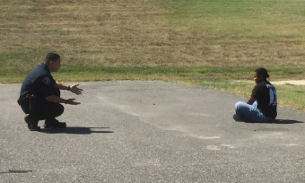
Tactical Communications
Your Goal: Make a Connection

Slide 15
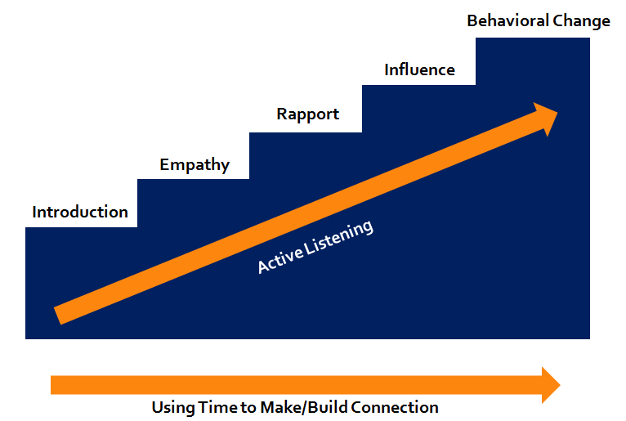
Tactical Communications
Behavioral Change Staircase
Adapted from FBI Behavioral Change Stairway Model

Slide 16
Tactical Communications
Some Things Not To Do
Don’t join in the person’s behavior
Don’t confuse the person
Don’t diminish the person
Don’t lie or deceive
Don’t automatically view non-compliance as a threat

Slide 17
Tactical Communications
Manage Your own Reactions
Officers can experience similar physiological changes as a subject in crisis
Important to consciously slow your breathing, move slowly and smoothly, stay in control
Control your body language
Your words need to match your demeanor

Slide 18
Tactical Communications
Appleton, WI
Notes:
Link to video: https://www.youtube.com/watch?v=jizOcTUlfV4

Slide 19
Tactical Communications
Active Listening Skills
Notes:
Call on Jeff Thompson

Slide 20
Tactical Communications
Active Listening Skills
Follow the 80-20 principle
Notes:
Call on Jeff Thompson

Slide 21
Tactical Communications
Active Listening Skills
Follow the 80-20 principle
Listen to understand, not just to respond
Notes:
Call on Jeff Thompson

Slide 22
Tactical Communications
Active Listening Skills
Follow the 80-20 principle
Listen to understand, not just to respond
Reduce distractions
Environmental factors
Public distractions (people videotaping)
Fellow officers
Your radio
Patrol vehicle lights
Notes:
Call on Jeff Thompson

Slide 23
Tactical Communications
Active Listening Skills
Follow the 80-20 principle
Listen to understand, not just to respond
Reduce distractions
Demonstrate you are listening
Physical cues
Minimal encouragers
Summarizing and repeating back
Acknowledgment
Notes:
Call on Jeff Thompson

Slide 24
Tactical Communications
Active Listening Skills
Follow the 80-20 principle
Listen to understand, not just to respond
Reduce distractions
Demonstrate you are listening
Use silence to your advantage
Notes:
Call on Jeff Thompson

Slide 25
Tactical Communications
Non-Verbal Communication Skills
Notes:
Call on Jeff Thompson

Slide 26
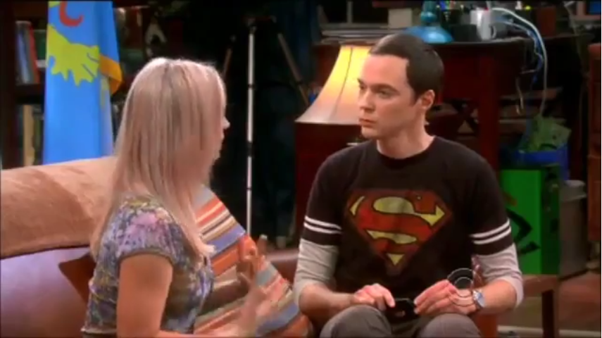
Tactical Communications
Big Bang Theory of Body Language
Notes:
Link to video: https://www.youtube.com/watch?v=ApvEhdSjP2g
Call on Jeff Thompson

Slide 27
Tactical Communications
Non-Verbal Communication Skills
Project the right body language
Posture
Appearance
Project a sense that you care
Notes:
Call on Jeff Thompson

Slide 28
Tactical Communications
Non-Verbal Communication Skills
Project the right body language
Make eye contact
Notes:
Call on Jeff Thompson

Slide 29
Tactical Communications
Non-Verbal Communication Skills
Project the right body language
Make eye contact
Use open-handed gestures
Notes:
Call on Jeff Thompson

Slide 30
Tactical Communications
Non-Verbal Communication Skills
Project the right body language
Make eye contact
Use open-handed gestures
Modulate your tone of voice
Notes:
Call on Jeff Thompson

Slide 31
Tactical Communications
Verbal Communication Skills
Notes:
Call on Jeff Thompson

Slide 32
Tactical Communications
Verbal Communication Skills
Use team concept
Notes:
Call on Jeff Thompson

Slide 33
Tactical Communications
Verbal Communication Skills
Use team concept
Establish rapport
Introduce yourself, ask the subject’s name
Speak on his/her terms
Be patient and tolerant
Be truthful & don’t over-promise
Notes:
Call on Jeff Thompson

Slide 34
Tactical Communications
Verbal Communication Skills
Use team concept
Establish rapport
Ask open-ended questions
Notes:
Call on Jeff Thompson

Slide 35
Tactical Communications
Verbal Communication Skills
Use team concept
Establish rapport
Ask open-ended questions
Provide clear, single questions / commands
Notes:
Call on Jeff Thompson

Slide 36
Tactical Communications
Verbal Communication Skills
Use team concept
Establish rapport
Ask open-ended questions
Provide clear, single questions / commands
Provide options
Notes:
Call on Jeff Thompson

Slide 37
Tactical Communications
Daytona Beach, FL
Notes:
Link to video: https://www.youtube.com/watch?v=MzbVm9UdSFg

Slide 38
Tactical Communications
Emotional Contagion
Your words and actions are contagious
What direction are you taking the encounter? Toward more chaos or …
Concept courtesy of Det. Jeff Thompson, NYPD
Voluntary Compliance
Notes:
Call on Jeff Thompson

Slide 39
Tactical Communications
Group Exercise
What’s wrong with these phrases?
What are better alternative statements?

Slide 40
Tactical Communications
Group Exercise
Phrase: “Come here!”
Alternatives:
“Can I ask you a question?”
“Can you tell me about it?”
“I want to know what’s going on.”

Slide 41
Tactical Communications
Group Exercise
Phrase: “Calm down!”
Alternatives:
“Talk to me.”
“It will be all right.”
“I can hear how angry/upset you are.”

Slide 42
Tactical Communications
Group Exercise
Phrase: “What’s your problem?”
Alternatives:
“How can I help you?”
“What can I do for you?”

Slide 43
Tactical Communications
Group Exercise
Phrase: “You should/should not do…”
Alternatives:
“What do you want to do?”
“What options have you considered?”
“Have you thought about …?”

Slide 44
Tactical Communications
Group Exercise
Phrase: “Drop the knife! Drop the knife! Drop the knife!”
Alternatives:
“Why don’t you put down the knife and we can talk?”
“Why are you holding the knife?”
“I’m concerned when you carry that knife – you might hurt yourself or someone else.”
“What can I do for you? I’m here to help you. But I need you to drop the knife.”

Slide 45
Tactical Communications
Quick Recap
Active listening – listening to understand (not just to respond)
Non-verbal communications are key
Dialogue, not debate – through open-ended questions
Emotional contagion
Notes:
Call on Jeff Thompson

Slide 46
Tactical Communications
Thoughts?
Questions?
Observations?

