Slide 1
Crisis Recognition

Slide 2
Crisis Recognition
Question to Consider
What are the key challenges police officers face when dealing with persons in behavioral crisis?

Slide 3
Crisis Recognition
Recognizing a Person in Crisis

Slide 4
Crisis Recognition
Behavioral Crisis: A Definition
An episode of mental and/or emotional distress that is creating instability or danger and is considered disruptive by the community, friends, family or the person him/herself
Adapted from the Seattle Police Department

Slide 5
Crisis Recognition
How Does a Crisis Typically Occur?
Precipitating event
Person’s perception of the event
Normal methods of coping fail
Resulting in …
Breakdown in control
Inability to respond appropriately
Feeling overwhelmed
Adapted from Police Training Institute
University of Illinois
Notes:
Call on Jeff Thompson

Slide 6
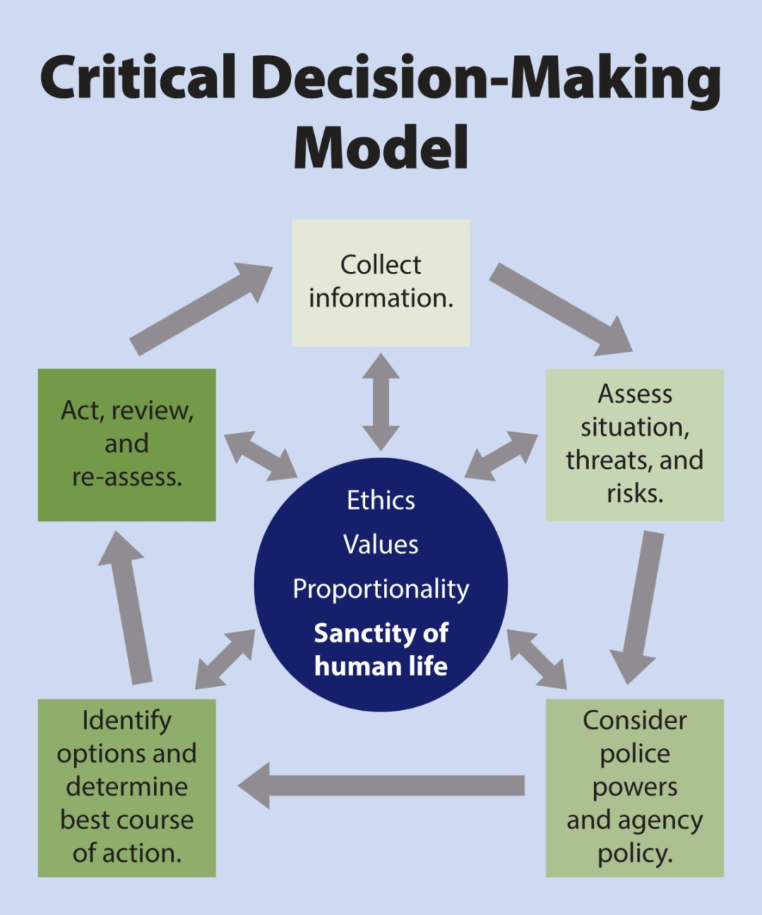
Crisis Recognition
Why Should I Care?
People in crisis need help
Crises can impact public and officer safety
It’s our job – to serve and protect
Reflects mission, values & ethics – sanctity of life
Notes:
Call on Jeff Thompson

Slide 7
Crisis Recognition
Mental
Illness
Perception disorder
Thought disorder
Mood disorder
PTSD
Emotionally Distressed Person
Adapted from Nassau County, NY Police Department
Notes:
Call on Jeff Thompson

Slide 8
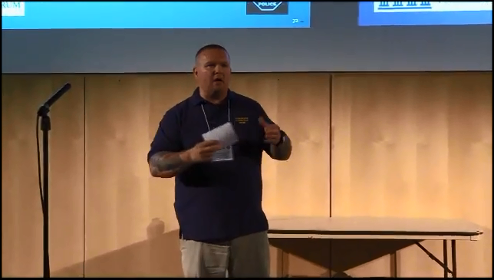
Crisis Recognition
Optional Video – Tim Wynn, Mentor for the Philadelphia Veterans Court
Notes:
Link to video: https://www.youtube.com/watch?v=ahIEwS0beFI

Slide 9
Crisis Recognition
Some Facts about People with Mental Illness
Biological illness like heart disease or cancer
Nobody “chooses” to develop a mental illness
There is no cure, but many people stabilize to live full, productive lives
Medications help, but they are not perfect and there can be episodes or side-effects
Adapted from Seattle Police Department

Slide 10
Crisis Recognition
Mental Health Statistics
1 in 5 adults lives with a mental illness:
1 in 25 adults lives with a serious mental illness
1.1% (2.4 million adults) live with schizophrenia
2.6% (6.1 million adults) live with bipolar disorder
10.2 million adults have co-occurring mental health and addiction disorders
Source: National Alliance on Mental Illness

Slide 11
Crisis Recognition
Mental Health Statistics
26% of adults staying in homeless shelters live with a serious mental illness
24% of state prisoners have a mental health condition
90% of those who commit suicide have an underlying mental illness
Source: National Alliance on Mental Illness

Slide 12
Crisis Recognition
Multicultural Mental Health Statistics
Living with a mental health condition:
19.3% of white adults
18.6% of African American adults
16.3% of Hispanic adults
Multicultural communities typically:
Have less access to treatment
Are less likely to receive treatment
Receive poorer quality of care
Language barriers
Have lower rates of health insurance
11% of transgender individuals reported being denied care due to bias or discrimination
Source: National Alliance on Mental Illness

Slide 13
Crisis Recognition
Children and Teen Mental Health Statistics
20% of teenagers live with a mental health condition
The delay between symptoms and treatment is 10 years
37% of students with a mental health condition drop out of school
70% of youth in state and local juvenile justice systems have a mental illness
Source: National Alliance on Mental Illness

Slide 14
Crisis Recognition
People with Mental Illness and the Criminal Justice System
People with serious mental illness can be violent
But most people with mental illness are not, and never will be, violent
Jail is often not a helpful place to get stabilized
Most people, even in a behavioral crisis, respond positively to kind and patient behavior
Sources: National Institute of Mental Health, U.S. Department of Health and Human Services

Slide 15
Crisis Recognition
Mental
Illness
Substance
Abuse
Alcohol
Illegal drugs
Synthetics
Combination
Emotionally Distressed Person
Adapted from Nassau County, NY Police Department
Notes:
Call on Jeff Thompson

Slide 16
Crisis Recognition
Mental
Illness
Substance
Abuse
Emotionally Distressed Person
Effects of Medication
Traumatic Brain Injury
Medical Condition
Adapted from Nassau County, NY Police Department
Notes:
Call on Jeff Thompson

Slide 17
Crisis Recognition
Mental
Illness
Substance
Abuse
Emotionally Distressed Person
Career
Financial
Relationship
Medical Condition
Situational
Stress
Adapted from Nassau County, NY Police Department
Notes:
Call on Jeff Thompson

Slide 18
Crisis Recognition
Persons with Intellectual and Development Disabilities
Autism spectrum disorder
Most common but not usually visibly apparent
Persons living with autism may engage in “stimming”

Slide 19
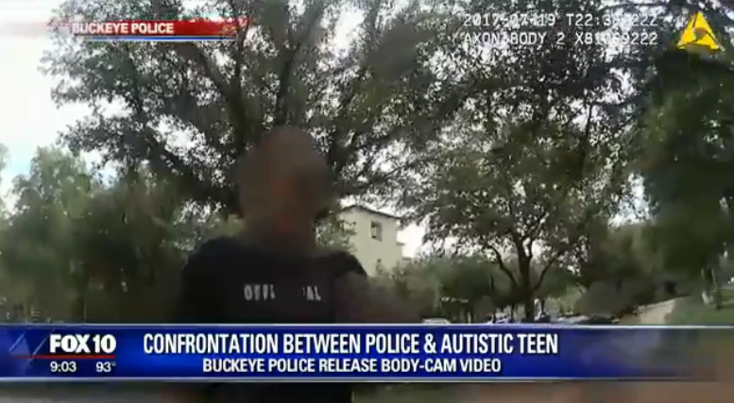
Crisis Recognition
Autistic Teen engaging in “stimming”
Notes:
Link:

Slide 20
Crisis Recognition
Persons with Intellectual and Development Disabilities
Autism spectrum disorder
Cerebral palsy
Epilepsy
Developmental delay
May result in difficulties in communication, adaptive living skills, self-direction, mobility.

Slide 21
Crisis Recognition
Persons with Physical Disabilities
Deaf/hard of hearing
Blind/low vision
Muscular Dystrophy
Multiple Sclerosis
Stroke
Alzheimer’s
Huntington’s Disease
Head/spinal cord injury
May make it difficult for people to hear, comprehend and follow directions – and to respond back to you.

Slide 22
Crisis Recognition
Persons with disabilities may exhibit same behaviors as EDPs
Don’t always assume it’s mental illness
Could be one of many factors – or a combination of several
Focus on subject’s behavior
Notes:
Call on Jeff Thompson

Slide 23
Crisis Recognition
Another Approach – Ask!
Ask the person …
Are you on medication?
Do you normally see a doctor?
Ask family members or friends nearby …
Does the person have a mental health condition?
A physical or developmental disability?
Ask Dispatch
Get more information, ask follow-up questions
Notes:
Call on Jeff Thompson

Slide 24
Crisis Recognition
Why do you want to know what’s behind someone’s erratic behavior?
Best approaches to help stabilize the situation
What communications strategies to employ
What additional resources you may need
Up-front awareness and recognition are key to a safe and effective response.
Notes:
Call on Jeff Thompson

Slide 25
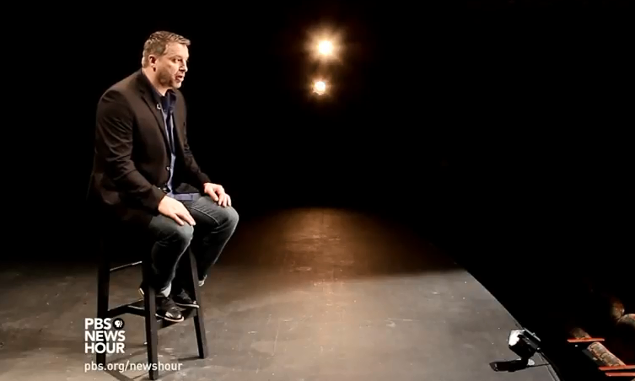
Crisis Recognition
What the encounter looks like from another perspective
Notes:
Link to video: https://www.youtube.com/watch?v=texgQ_ZtsLw

Slide 26
Crisis Recognition
Suicide by Cop
- Content Courtesy of NYPD Detective Jeff Thompson, Ph.D.

Slide 27
Crisis Recognition Suicide by Cop
Definition:
A deliberate act motivated, in whole or in part, by the subject’s desire to die by suicide, which provokes the law enforcement officer(s) to act, with the result being a justifiable homicide by the officer(s).
-Detective Jeff Thompson, NYPD

Slide 28
Crisis Recognition Suicide by Cop
Suicide-by-Cop criteria:
Voluntarily enter into a confrontation with law enforcement
Communicate suicidal intent (verbal or actions)
Act in a threatening manner to the police

Slide 29
Crisis Recognition Suicide by Cop
Suicide by cop is prevalent … and often unpredictable
Study of 700 officer-involved shootings
36% were suicide-by-cop incidents
17% of these suicides were planned
81% were spontaneous
Mohandie, Meloy, and Collins. “Suicide by Cop Among Officer-Involved Shooting Cases.” Journal of Forensic Science (2009)

Slide 30
Crisis Recognition Suicide by Cop
Suicide-by-Cop Subjects:
History of mental illness – 62%
Unknown mental illness – 32%
Under the influence of a controlled substance – 17%
Intoxicated – 36%
Thought disorder – 15%
Prior criminal history – 66%
Mental
Illness
Substance
Abuse
Emotionally Distressed Person
Medical Condition
Situational
Stress

Slide 31
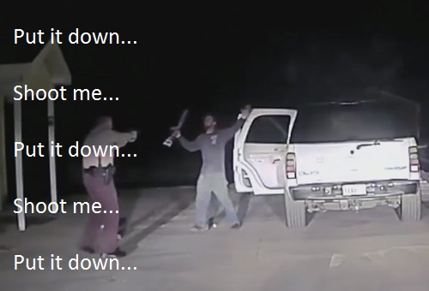
Crisis Recognition Suicide by Cop
Subject may be experiencing a wide range of emotions and characteristics including
Anger
Agitation
Resoluteness
Defiance
Desperation
We know that when a subject’s emotions are running high, their rational thought is low.

Slide 32
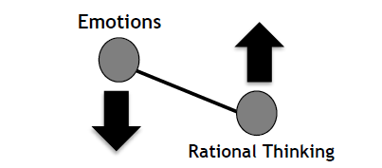
Crisis Recognition Suicide by Cop
The Emotional-Rational Thinking Scale
Courtesy of Detective Jeff Thompson, NYPD

Slide 33
Crisis Recognition
Quick Recap
There could be many causes for a person to be in crisis – mental illness is one of them
Your priority is not to diagnose and resolve the situation – it’s to defuse, stabilize and get help

Slide 34
Crisis Recognition
Quick Recap
As emotions rise, rational thinking declines – lowering their emotions helps people think more rationally
Empathy, communication, respect, making a connection – all about trying to get voluntary compliance

Slide 35
Crisis Recognition
Thoughts?
Questions?
Observations?

