Slide 1

The Critical
Decision-Making Model

Slide 2

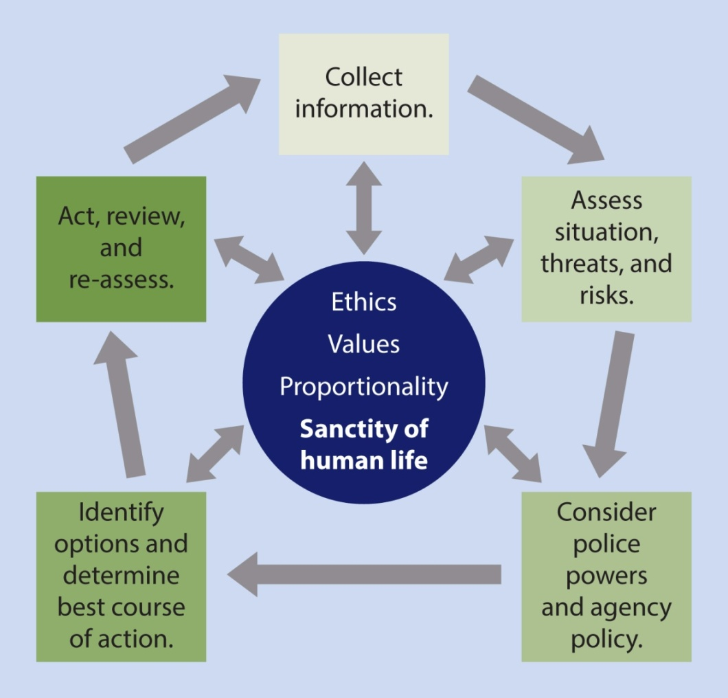
The Critical
Decision-Making Model

Slide 3

The Critical
Decision-Making Model
CDM Core
Ideals that define the agency
  Ethics, values, mission statement, guiding principles and priorities
  Core informs/guides each step in the model

Slide 4
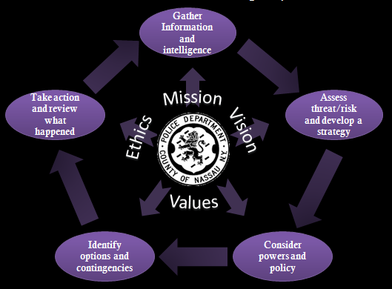
The Critical
Decision-Making Model
CDM Core
Nassau County, NY Police Department
  Mission
  Vision
  Values
  Ethics

Slide 5
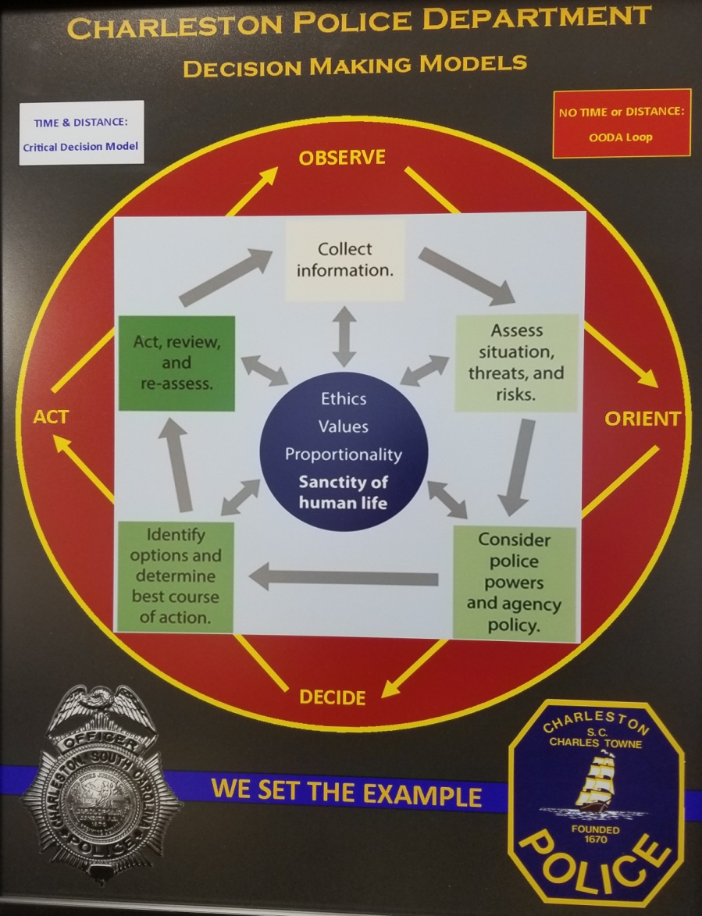
The Critical
Decision-Making Model

Slide 6
The Critical
Decision-Making Model

Slide 7

The Critical
Decision-Making Model
Step 1: Collect Information
Ask yourself …
What do I know about this incident (subject, victim, location)?
What else do I need to know?
What do my training and experience tell me about this type of incident?

Slide 8
The Critical
Decision-Making Model
Step 1: Collect Information
Ask others (esp. Dispatch) …
What more can you tell me about this incident?
What more can you tell me about previous incidents involving this location or subjects?

Slide 9
The Critical
Decision-Making Model
Step 1: Collect Information
Information collection is an ongoing process throughout the CDM … it doesn’t stop at Step 1
If you’re not getting the information you need … keep asking!

Slide 10

The Critical
Decision-Making Model
Coeur d’Alene, ID
Notes:
Link to video: https://www.youtube.com/watch?v=_FcrJDhelug

Slide 11
The Critical
Decision-Making Model
Step 2: Assess Situation, Threats & Risk
Ask yourself …
Do I need to take immediate action?
What more information do I need?
Am I trained and equipped to handle this situation myself
What is the threat/risk?

Slide 12
The Critical
Decision-Making Model
Threat Assessment
Accurately assess person, object or environmental factors that could put officer/public at risk
Two risk categories at this stage:
  High risk
  Unknown risk
Guard against officer complacency

Slide 13
The Critical
Decision-Making Model
Threat Assessment
Assess the subject’s:
Means
Ability
Opportunity
Intent
Watch out for “transfer of malice”
(or aggression)

Slide 14
The Critical
Decision-Making Model
Begin developing a working strategy
Minimize risk to victim and public
Maximize officer safety
Minimize risk to subject
Allow for safe detention of subject
Allow for recovery, preservation of evidence

Slide 15
The Critical
Decision-Making Model
Step 3: Consider Police Powers & Agency Policy
Ask yourself …
What legal powers do I have to take action?
What agency policies control my response?
Are there other issues I should think about (jurisdictional matters, mutual aid, etc.)?

Slide 16
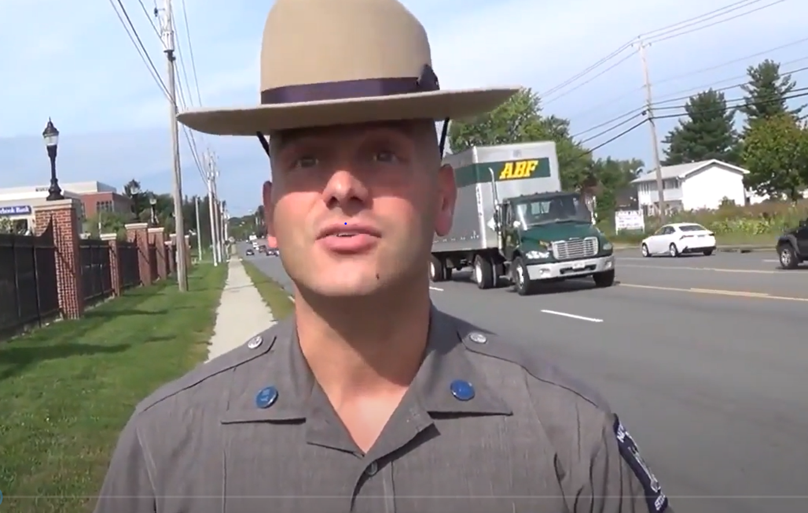
The Critical
Decision-Making Model
New York State Police attempts to ID individual
Notes:
Link to video: https://www.youtube.com/watch?v=jlb7goXKxFQ&feature=youtu.be

Slide 17
The Critical
Decision-Making Model
Step 4: Identify Options, Determine Best Course of Action
Ask yourself …
What am I trying to achieve?
What options do I have?
What contingencies must
I consider if I choose a particular option?
Do I need to act now, or can I wait?

Slide 18
The Critical
Decision-Making Model
Possible Options and Contingencies
Wait and collect more information
Keep subject under observation
Continue communicating with subject
Tactically reposition and contain the area
Take decisive action

Slide 19
The Critical
Decision-Making Model
Select Best Course of Action
Keeping in mind …
Greatest likelihood of success against least harm
How proportional the response will be (given threat/risks)
Safety of the public, your own safety and the sanctity of all life
Agency mission and values (CDM core)

Slide 20
The Critical
Decision-Making Model
Step 5: Act, Review and Re-assess
Execute the plan, then ask yourself …
Did I achieve the desired outcome?
Is there anything more I need to consider?
What lessons did I learn?
If the incident is not resolved, then “spin the model”

Slide 21

The Critical
Decision-Making Model
“Spinning the Model”
Information collection is ongoing
As new information comes in, ask yourself:
  What is the threat?
  What are my options?
“Spinning the model” means re-assessing, fine-tuning your decision-making

Slide 22
The Critical
Decision-Making Model
How does this benefit me?
(Esp. in tense and dynamic situations?)
Nothing prevents officers from taking immediate action
When there is time, CDM provides a useful structure for weighing options, making decisions
Very similar to what SWAT teams already do
Over time, it becomes second-nature … like driving a car

Slide 23
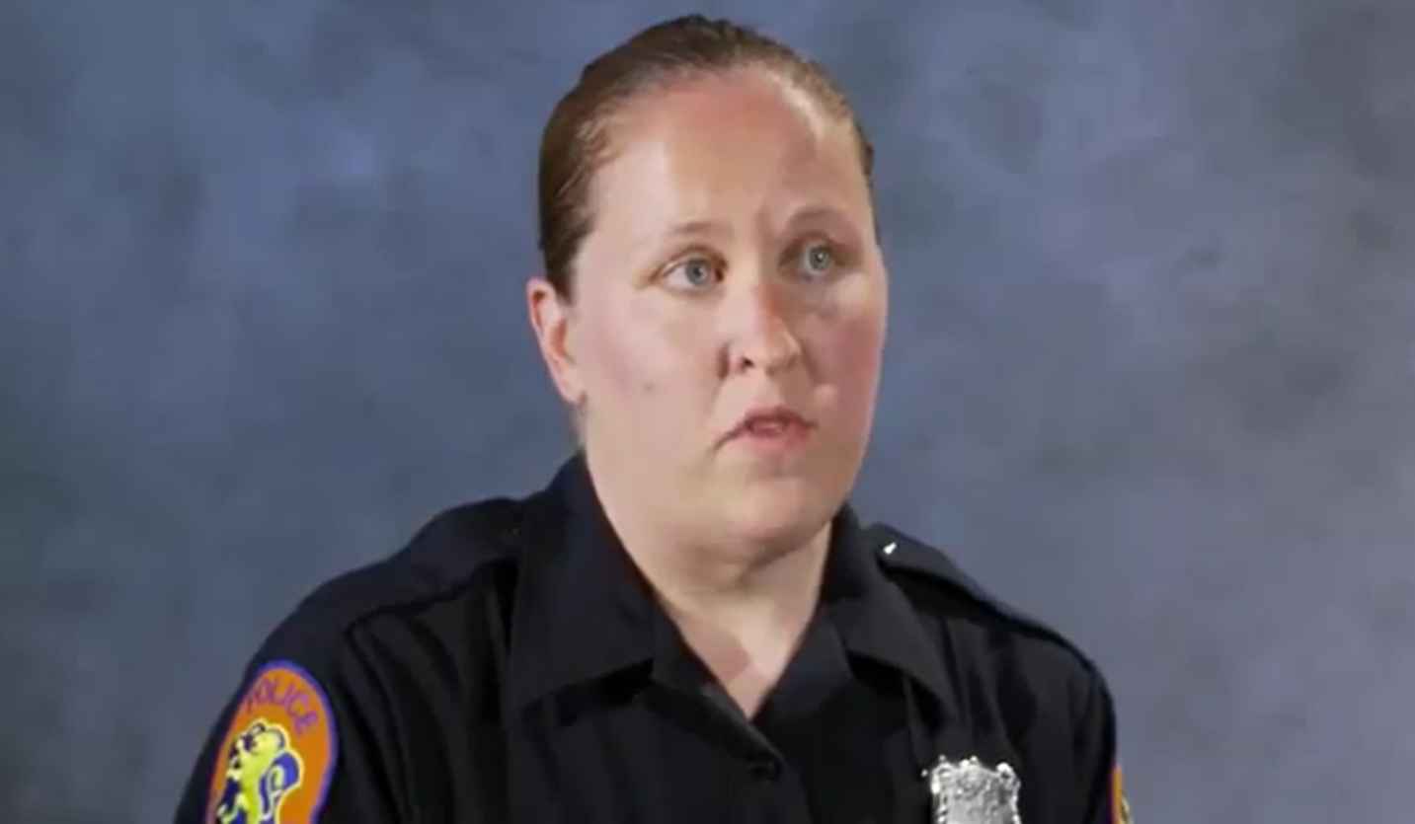
The Critical
Decision-Making Model
One Agency’s Experience:
Nassau County (NY) Police Department
Notes:
Link to video: https://www.youtube.com/watch?v=5NCYvsEBAPU

Slide 24
The Critical
Decision-Making Model
Benefits of the CDM
Better decisions up front
  “I didn’t have time to think” – very few situations where that is really the case
  CDM helps you gather information, assess threats, weigh options
Helps to explain your actions after the fact
  Enhances officer credibility
  Protects officers in court

Slide 25

The Critical
Decision-Making Model
Looking at the CDM in Action
Notes:
Link to video: https://www.youtube.com/watch?v=VBY7zzsQVnU

Slide 26
The Critical
Decision-Making Model
Coeur d’Alene, ID
Notes:
Link to video: https://www.youtube.com/watch?v=_FcrJDhelug

Slide 27
The Critical
Decision-Making Model

Slide 28
The Critical
Decision-Making Model
Thoughts?
Questions?
Observations?

