Slide 1
Introduction

Slide 2
EMBED VIDEO MESSAGE
FROM THE CHIEF EXECUTIVE
[OPTIONAL]

Slide 3
Each year in the United States …
327,000,000 residents
53,500,000 police contacts

Slide 4
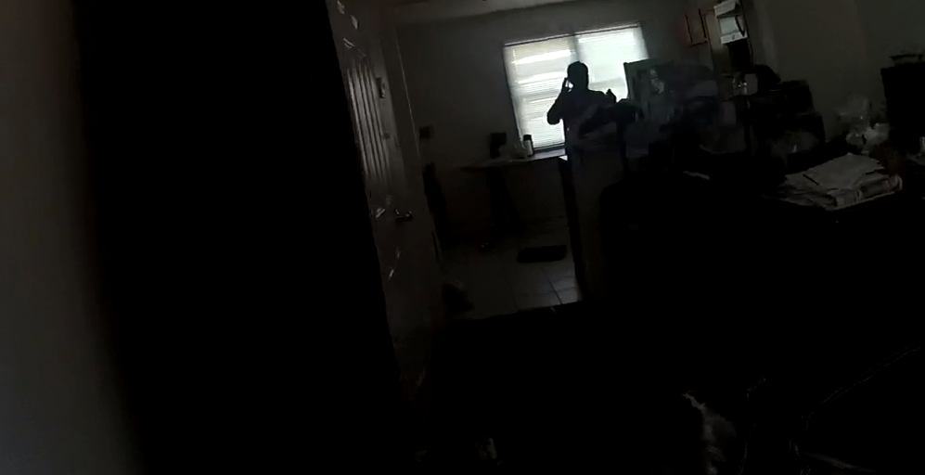
Woman in-crisis in Baltimore, MD
Notes:
Link to video:

Slide 5
Each year in the United States …
327,000,000 residents
53,500,000 police contacts
10,700,000 arrests
985,000 UOF
1,000 deaths

Slide 6
Radio Traffic – St. Louis Incident
Notes:
Link to audio: http://www.stltoday.com/online/audio-and-video-evidence-in-kajieme-powell-shooting/collection_b051817e-88bf-5b97-b09c-524e98538ad4.html

Slide 7
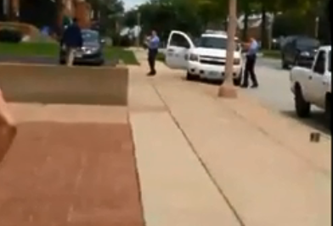
Patrol Officer Response – St. Louis Incident
Notes:
Link to video: https://www.youtube.com/watch?v=FsIlLKOya3c

Slide 8
What challenges did these officers face?

Slide 9
What challenges did these officers face?
Enough information from Dispatch?
Person with a knife… a potentially dangerous encounter
Behaving erratically
Non-compliant … disregarded orders to drop the knife
Officer and public safety
Suicide by cop … shouting “shoot me”

Slide 10
These encounters are not easy …
Can we handle them more effectively and more safely … for everyone?

Slide 11
Challenging Conventional Thinking
“We don’t have all day”
Retreating vs. Tactical repositioning
Not having a Plan B
Drawing a line in the sand
“21-foot rule” vs. Reaction gap
Not taking action is a “failure to act”
“The most important thing is that I go home safely,” vs. “The most important thing is that we all go home safely.”

Slide 12
This training is about …
Creating More
Options

Slide 13
What this training covers
Critical Decision-Making Model
Crisis Recognition
Tactical Communications
Operational Tactics
Scenario-Based Training

Slide 14
What this training covers …
Skills you already use on a daily basis
Pulls those skills together – applies them to non-firearms critical incidents
Emphasis on teamwork
Focus on persons in crisis, “suicide-by-cop” situations

Slide 15
What the training is not…
Not telling officers to walk away or ignore dangerous situations
Not trying to put you in an unwinnable situation
Not telling officers they can’t use force – including lethal force – when appropriate
Not about limiting options for officers … rather, it’s about increasing options

Slide 16
Four key areas:
Patrol officer response

Slide 17
Four key areas:
Patrol officer response
Non-firearms incidents

Slide 18
Four key areas:
Patrol officer response
Non-firearms incidents
Integration of crisis recognition, communications & tactics – to gain voluntary compliance when possible

Slide 19
Four key areas:
Patrol officer response
Non-firearms incidents
Integration of crisis recognition, communications & tactics
Officer safety & wellness—physical, emotional, legal

Slide 20
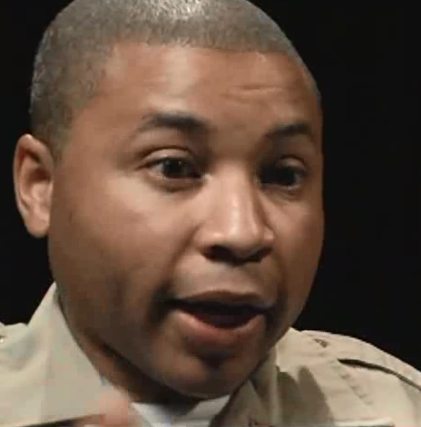
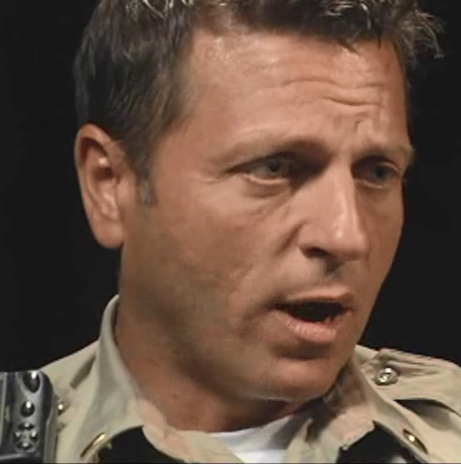
Las Vegas Metropolitan Police Department Testimonial Video
[OPTIONAL]

Slide 21
Making the job of the
patrol officer …
Safe. Effective.

Slide 22
Thoughts?
Questions?
Observations?

