Slide 1


Introduction

Slide 2
About ICAT
ICAT is a training program that gives police officers tools for defusing critical incidents – especially those that do not involve suspects with guns
ICAT was created by PERF with input from working cops
Lessons from abroad: Most police officers in Scotland do not carry firearms, so they are taught de-escalation skills
American SWAT units typically have these same de-escalation tactics

Slide 3
About ICAT (II)
ICAT brings SWAT-type skills to patrol officers
PERF held national and regional meetings of hundreds of police officials to develop ICAT’s principles
PERF pilot-tests ICAT in seven police departments. Today, more than 600 agencies have received ICAT training
ICAT is continually updated. A new module was added in 2019 on Suicide by Cop incidents

Slide 4
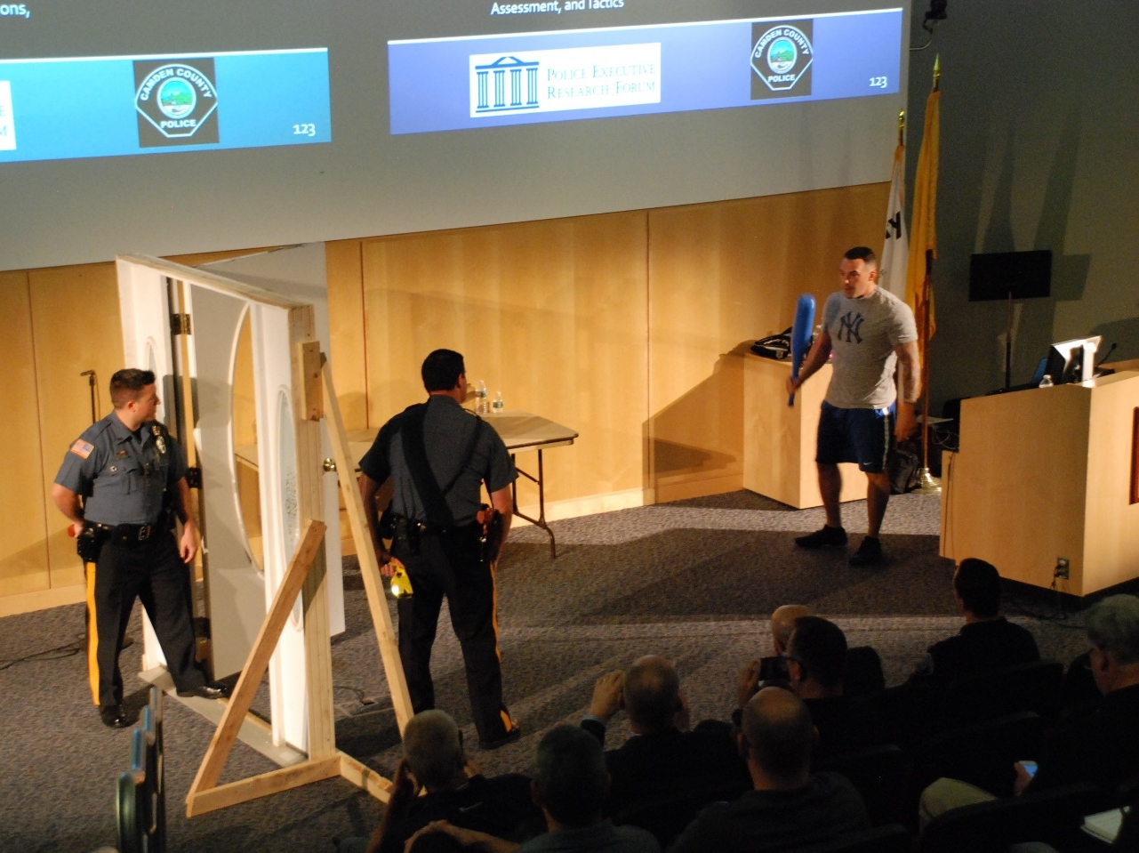
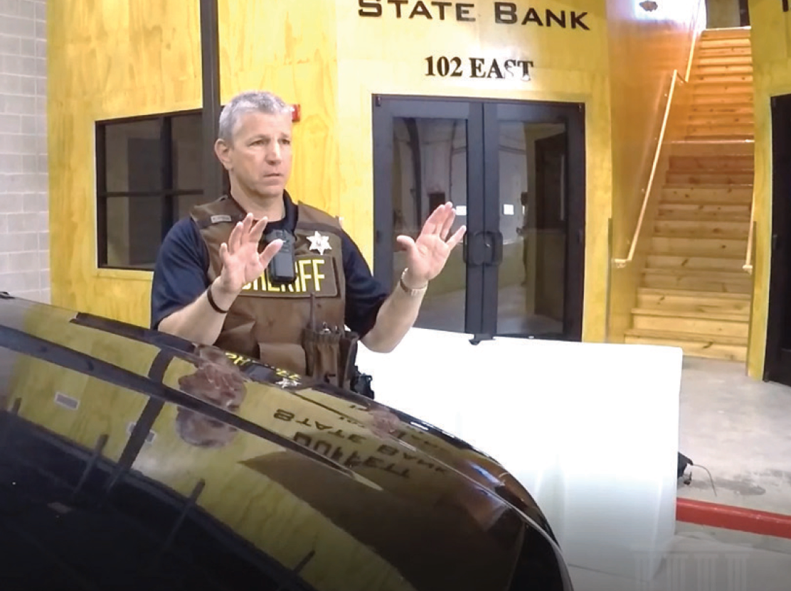
About ICAT (III)
ICAT Training:
Camden County, NJ
Suicide by Cop scenario-based training:
Decatur, IL

Slide 5
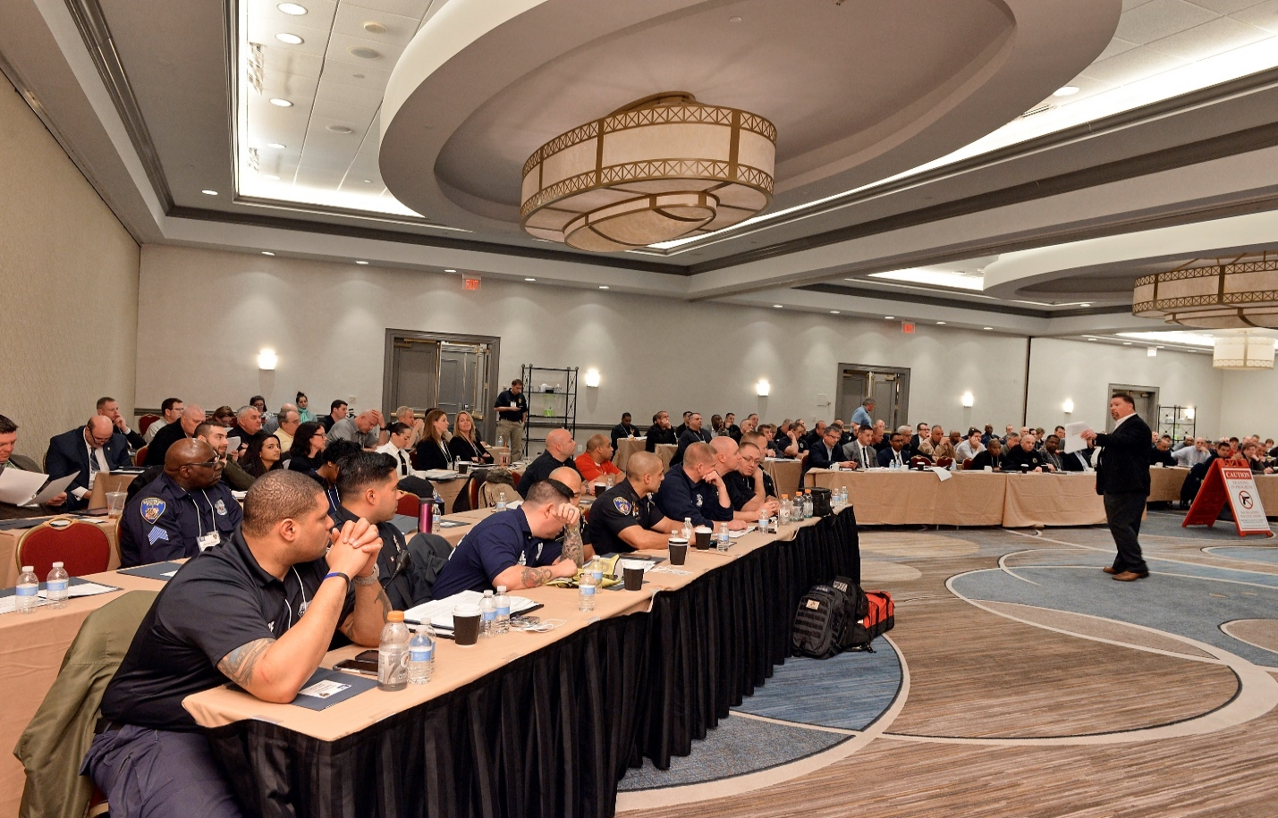
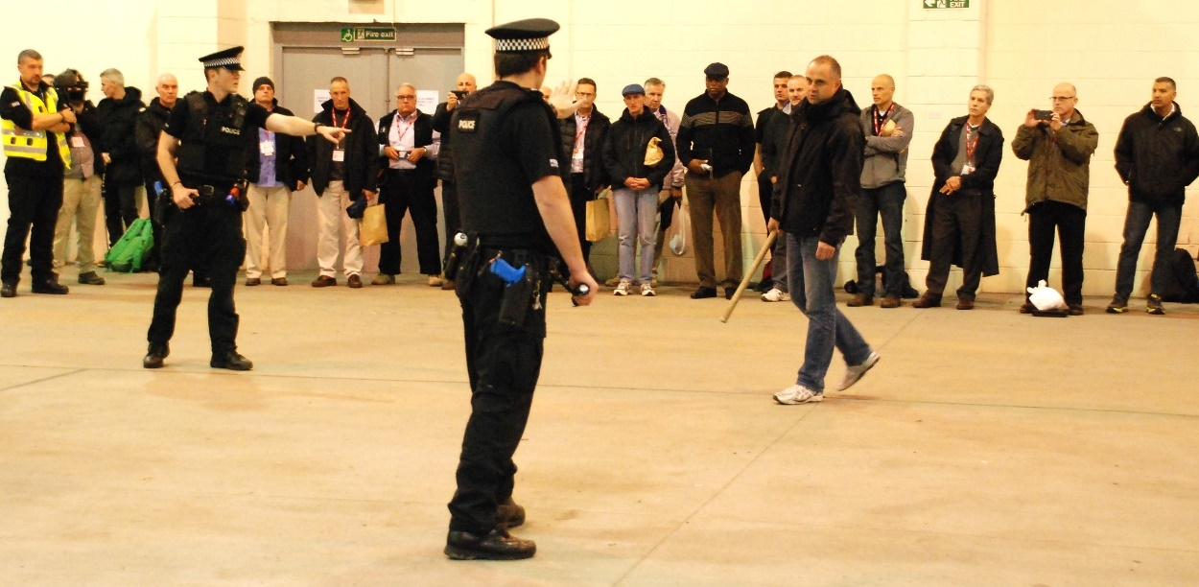
About ICAT (IV)
ICAT Training:
Baltimore, MD (2017)
Police Scotland, November 2015

Slide 6
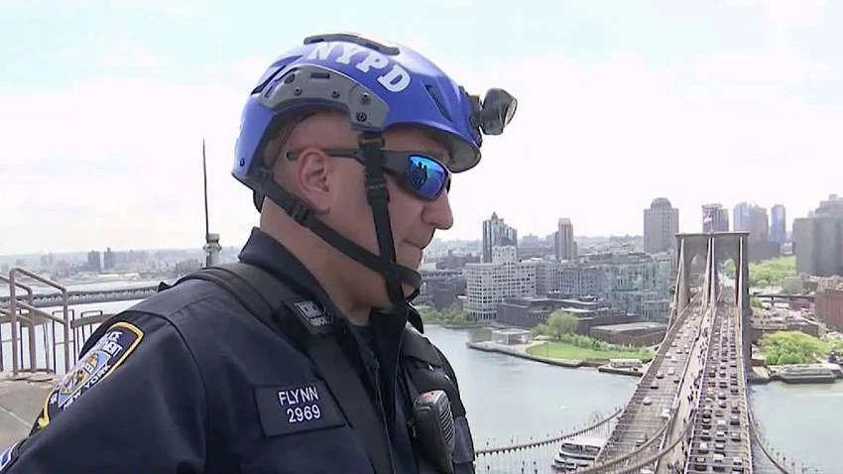
This training is about creating
more options
“Throughout the process, we reminded each other that we were looking to give officers more tools and options, not less. ICAT would not take anything away and it would seek to make these incidents safer for everyone.”
-Sgt. John Flynn
(NYPD ESU)

Slide 7
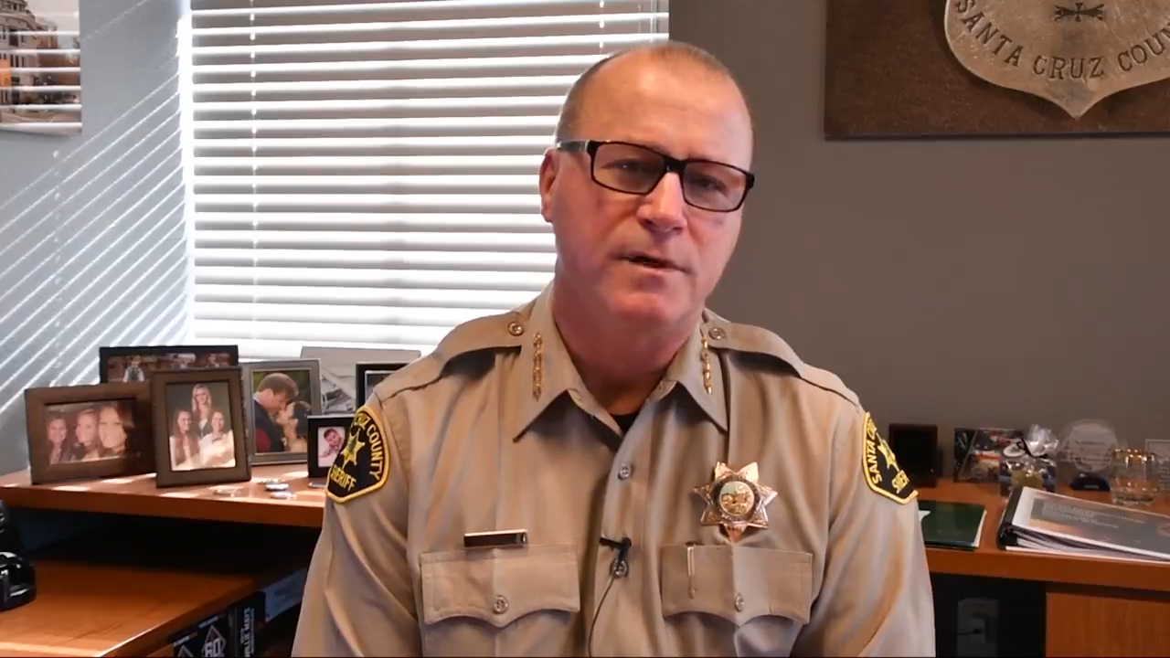
Sheriff Jim Hart:
The Impact of ICAT

Slide 8
LEAs Using ICAT

Slide 9
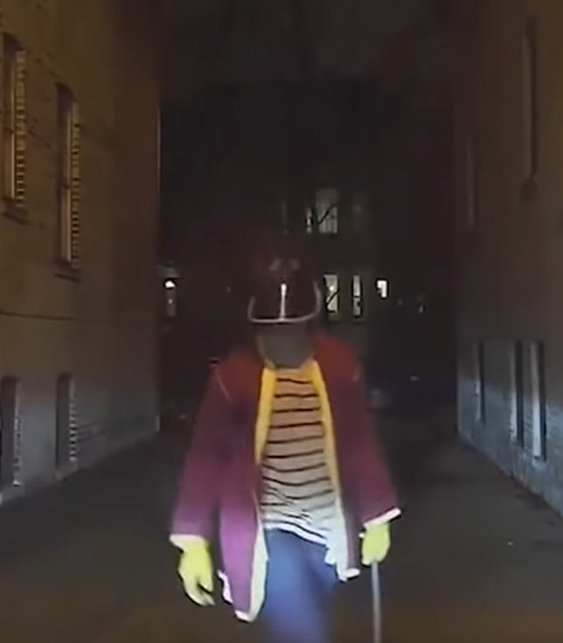
ICAT’s Focus
Incidents in which a subject in crisis is unarmed,
or armed with a weapon other than a firearm

Slide 10
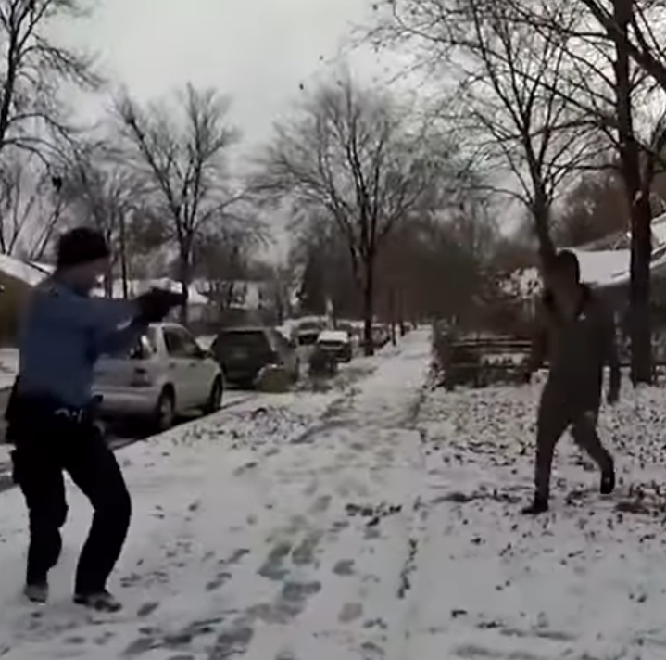
ICAT’s Focus (II)
In approximately 40% of fatal OISs, the subject is unarmed or armed with something other than a firearm
Source: The Washington Post

Slide 11
ICAT Research
According to a lengthy, rigorous study involving hundreds of officers at the Louisville Metro (KY) PD, ICAT resulted in:
28.1%
Reduction in
Use of Force Incidents
26.3%
Reduction in
Citizen Injuries
36.0%
Reduction in
Officer Injuries
Engel, Corsaro, Isaza, & McManus (2020)

Slide 12
ICAT Research (II)
Study results indicate that ICAT led to changes in officer behavior associated with and surrounding the use of force (e.g. injuries to officers and suspects). According to Dr. Robin Engel, this is the first study of a police de-escalation program to show changes in both officer attitudes and behavior.
Engel, Corsaro, Isaza, & McManus (2020)

Slide 13
ICAT Research (III)
“The research team is confident that the changes in uses of force – and the subsequent reductions in citizen and officer injuries – corresponded with the timing of the [ICAT] training across the various police divisions.”
Engel, Corsaro, Isaza, & McManus (2020)

Slide 14
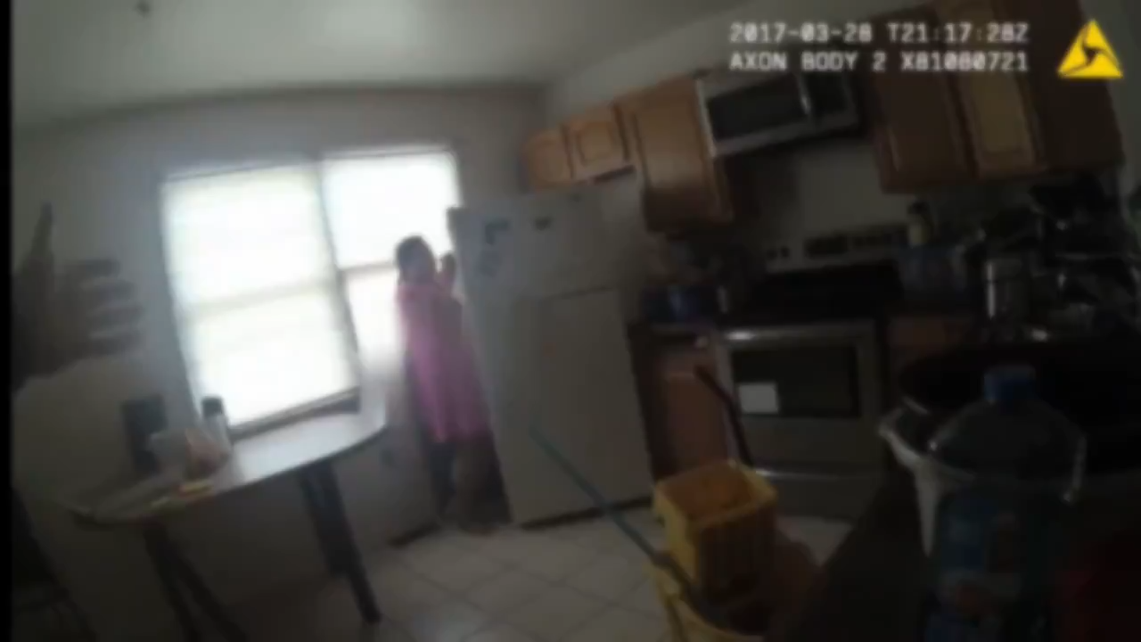
Case Study
March 2017: Baltimore, MD
Children report that their mother is in crisis, in the home, armed with a knife

Slide 15
Consider:
These encounters are not easy and pose many challenges.
Can we do things more effectively and more safely for everyone?

Slide 16
Challenging Conventional Thinking
“We already do this” (CIT)
Use of force continuum vs proportionality
“21-foot rule” vs. reactionary gap
“We don’t have all day”
Retreating vs. tactical repositioning
Not having a Plan B
Drawing a line in the sand
Not taking action is a “failure to act”
“The most important thing is that I go home safely” vs. “The most important thing is that we all go home safely.”
Winning at all costs?

Slide 17
This training covers:
Skills you already use and depend on:
  Critical decision-making
  Crisis recognition
  Tactical communications
  Suicide by cop
  Operational tactics
  Stepping up and stepping in
  Scenario-based training (with emphasis on teamwork)
ICAT integrates those skills - applied to non-firearm critical incidents
Focus on persons in crisis, “suicide by cop” situations

Slide 18
This training is NOT:
Telling officers to walk away from or ignore danger
Trying to put you in an unwinnable situation
Telling officers they can’t use force – including lethal force – when appropriate
Limiting options for officers (ICAT is actually about increasing options, which enhances safety)

Slide 19
Focus
Patrol response
Non-firearms incidents
Integration of crisis recognition, communications, and tactics
Officer safety and wellness- physical, emotional, legal

Slide 20
Implementation
Consider training telecommunicators with officers
Careful consideration needs to be given for the selection of trainers and role-players
Depending on your agency, ICAT could jump-start a change in culture
Focus on improving responses, not dwelling on “what went wrong”
This is all about more options for responding officers

Slide 21

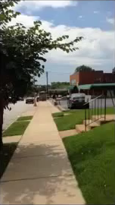
Case Study
August 2014:
St. Louis, MO
Two 9-1-1 calls:
  Male subject had taken items from a store
  Info update:
  Subject now pacing in front of same; armed with a knife
1st 911 call
1st dispatch
2nd 911 call
2nd dispatch
What challenges did these officers face?

Slide 22
Challenges
Enough info from dispatch?
  Additional info requested?
Armed with a knife - potential danger?
Behaving erratically
Non-compliant
Officer and public safety
Suicide by cop

Slide 23
Leadership Snapshot
Effective leadership begins long before the call for service comes in
Leaders must be willing to take responsibility from the moment of dispatch
Get the information you deem important — first-hand if need be
Embrace the research
Go to the scene and be visible; Do not assume they will not need you

Slide 24
Leadership Snapshot (II)
Know your team and keep them in winnable situations
Celebrate successful outcomes
Consider: In the St. Louis video, if a supervisor had been dispatched after it was learned the subject was armed with a knife, how might they have altered the response?

Slide 25
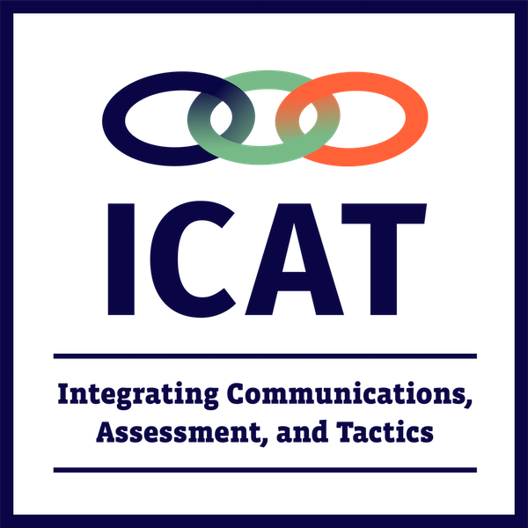
Thoughts?
Questions?
Observations?

